Slide 1
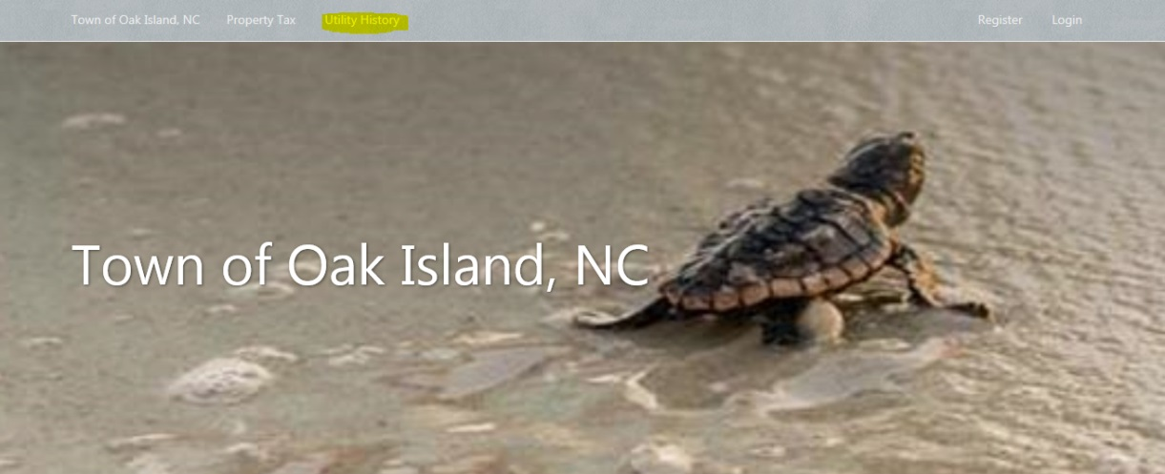
Setting Up Utility Lookup
Go to https://www.municipalonlinepayments.com/oakislandnc
Click on Utility History

Slide 2
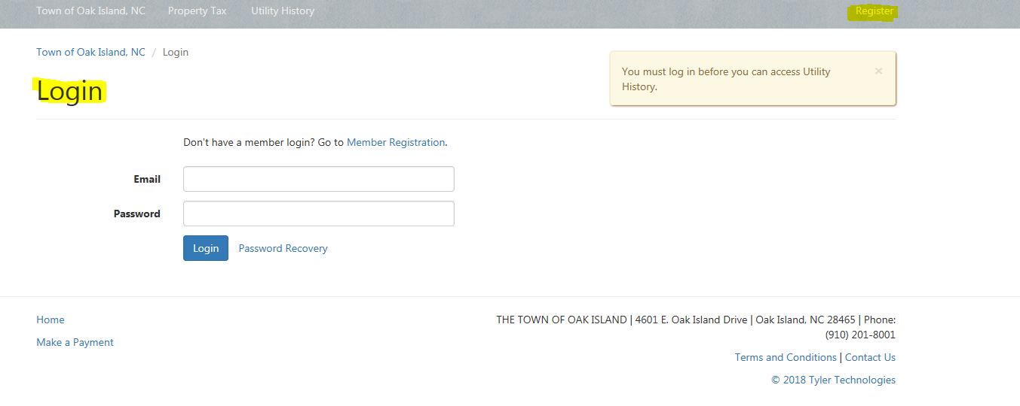
Cont….
Click Register if you have not set up an account already.
If you have set up an account or are wanting to log in after you set your account up, put in your email and password under the Login.

Slide 3
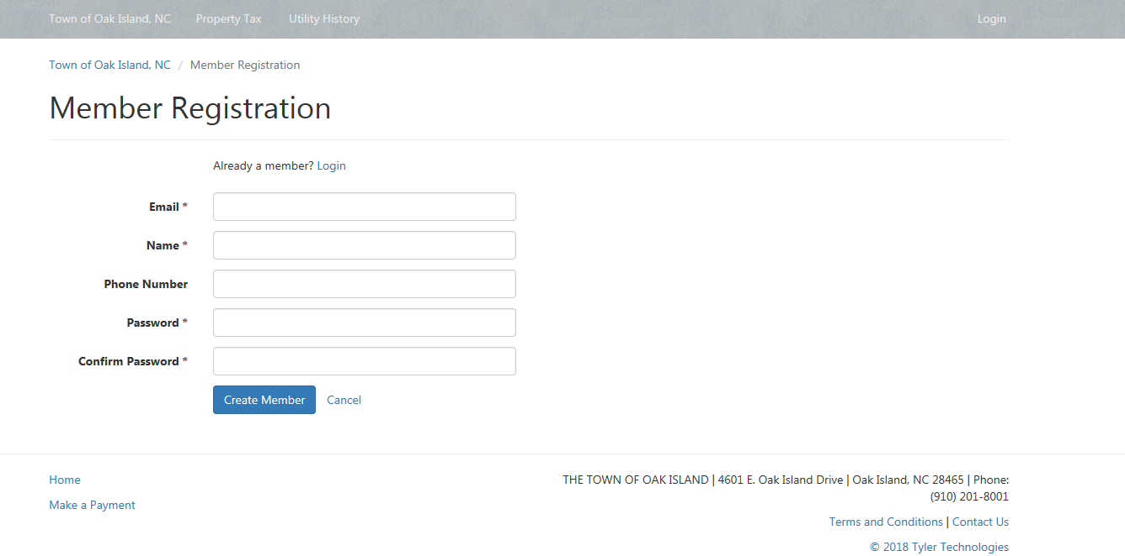
Cont..
If you are registering, once you click register this will be your next page. You will enter the below information and press Create Member.

Slide 4
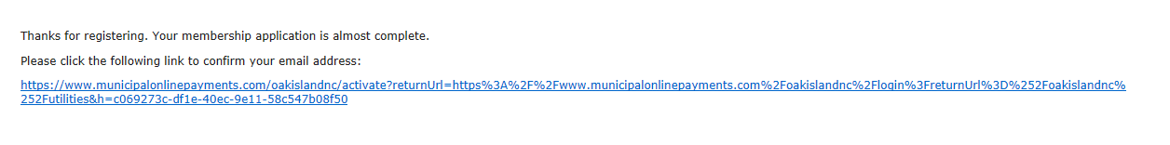
Cont…
Once you click create member you will get a message stating it has sent you an email. Below is who the email will be from.
You will then click on the link included in the email. Below is what the email will look like.

Slide 5
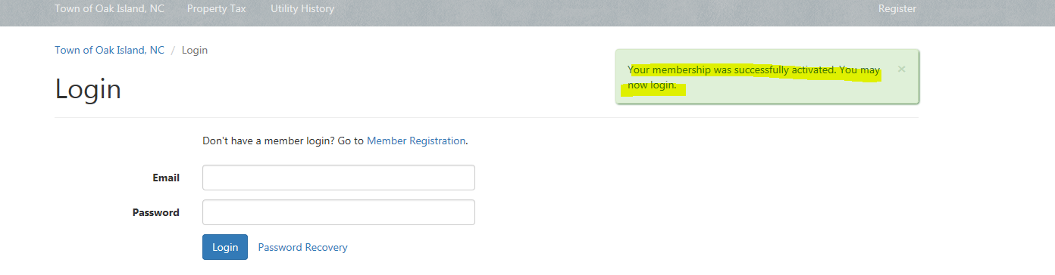
Cont..
Once you click that link, you should get the below message.
Then you will need to log in.
Then enter your email you set up and your password.

Slide 6
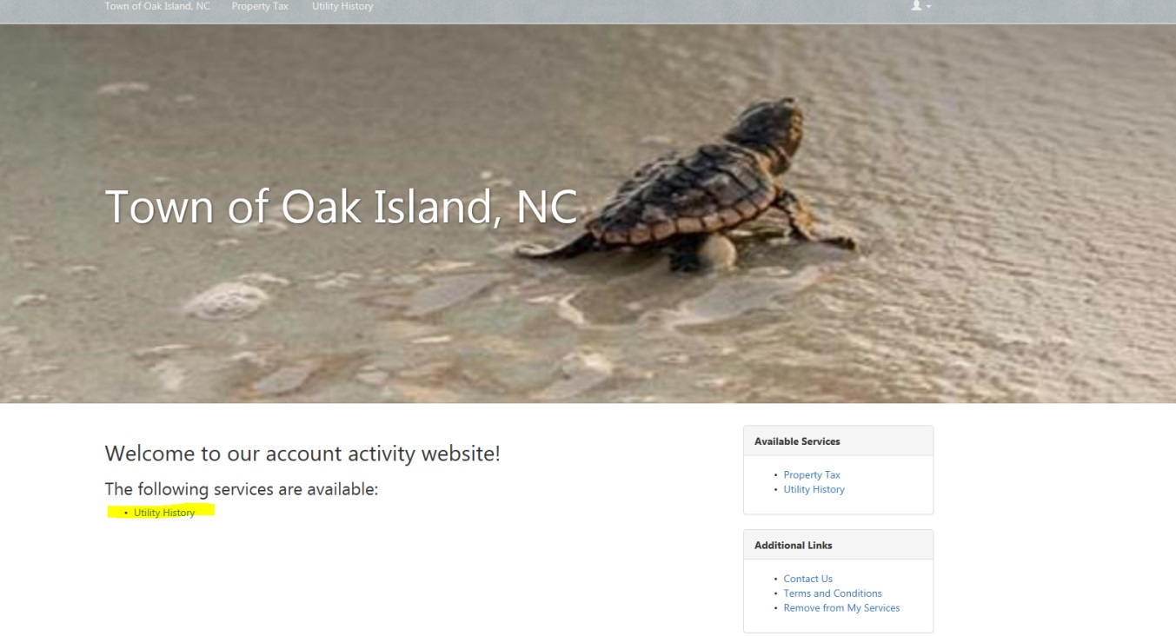
Cont..
Once you enter your login information you will then be at this screen. You will click Utility History.

Slide 7
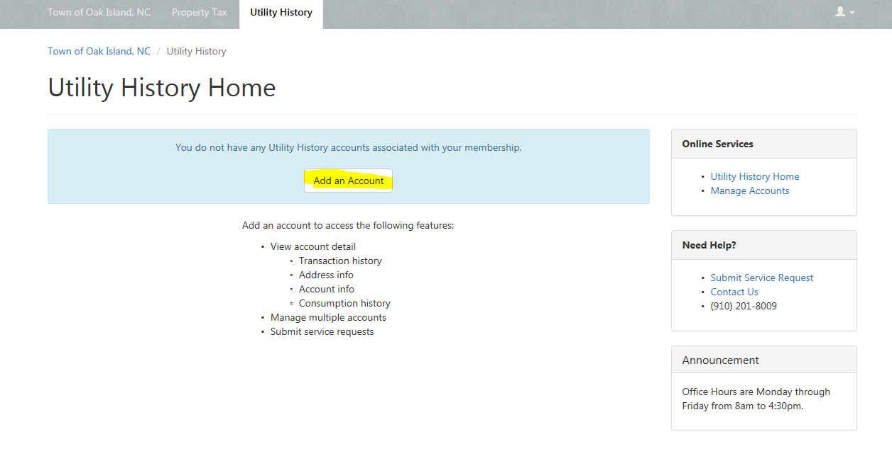
Cont..
Then you will click Add an Account.

Slide 8
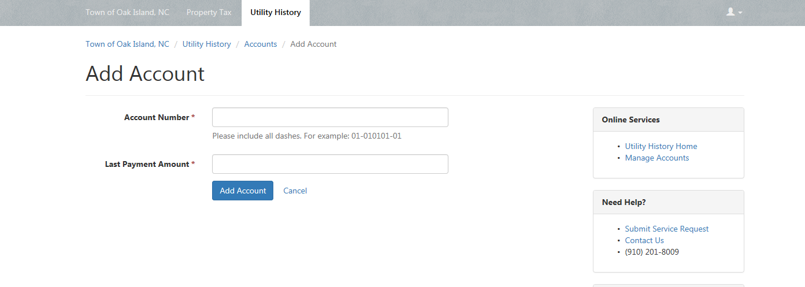
Cont..
You will then put in your account number and last payment amount. (If you have multiple accounts, you will do this for each one. Then press Add Account

Slide 9
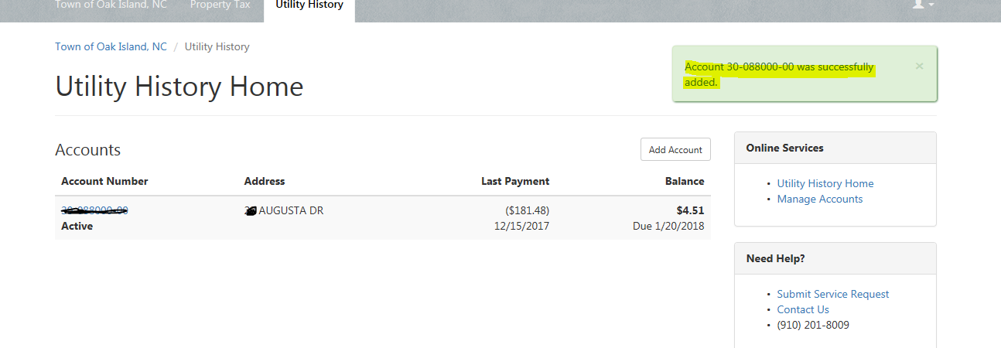
Cont..
This will be the next screen and you should see that message saying your account was added successfully. You will also see your account number and address along with the last payment and balance.

Slide 10
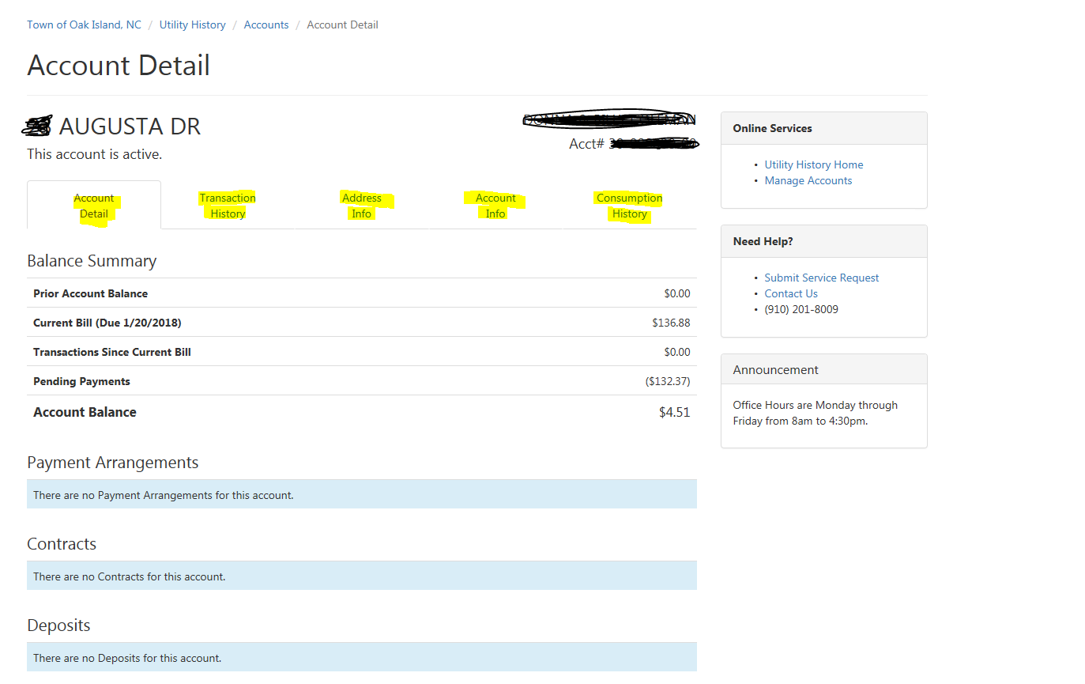
Cont..
It will then make you sign back in and this will be what you see. You have a couple options. Account detail, transaction history, address info, account info, and consumption history.

Slide 11
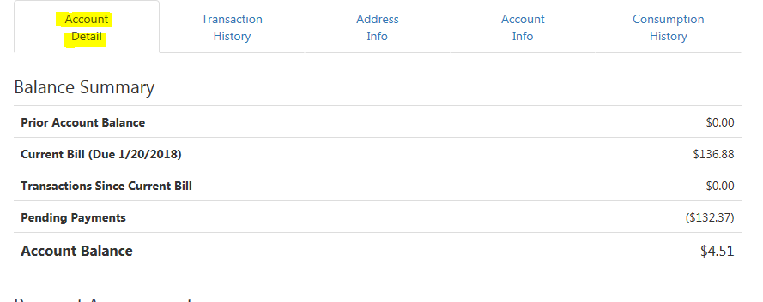
Cont..
Account Detail: This shows your prior account balance, current bill and when its due by, transactions since current bill, and if you have any pending payments. So this one does not have any past due balances, they have a current bill of 136.88 due by 1/20/2018. However they have a pending payment of $132.37 which makes their balance $4.51

Slide 12
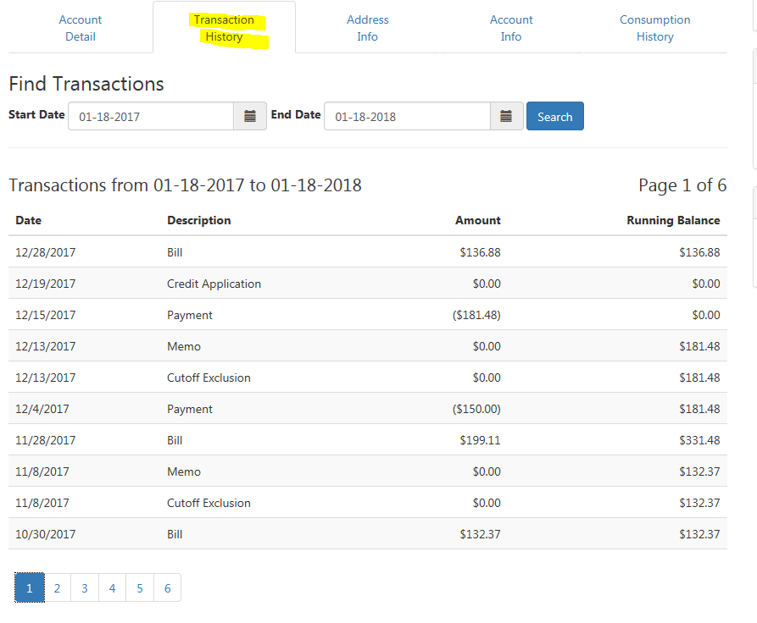
Cont..
Transaction History: This shows everything, your bill that went out and the amount any payments we have received and any late fees or non-payment penalty's.

Slide 13
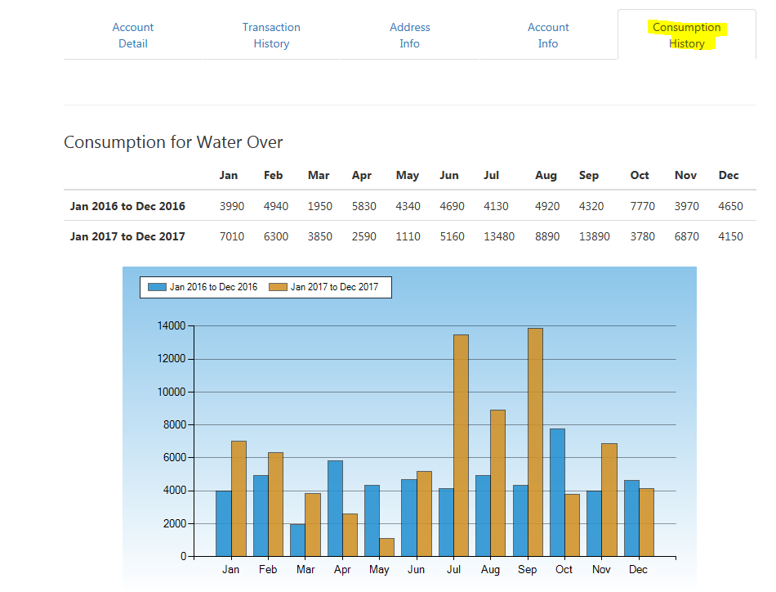
Cont..
Consumption History: This shows your usage, in number and graph form.

