Slide 1
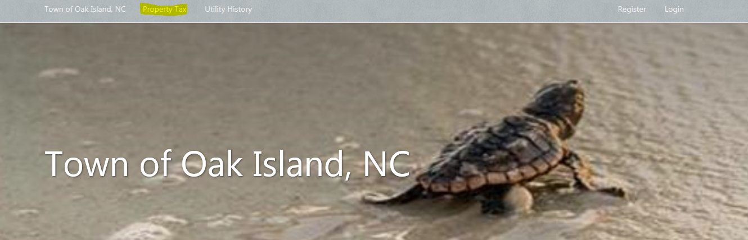
Looking Up Taxes Online
Go to https://www.municipalonlinepayments.com/oakislandnc
Click Property Tax

Slide 2
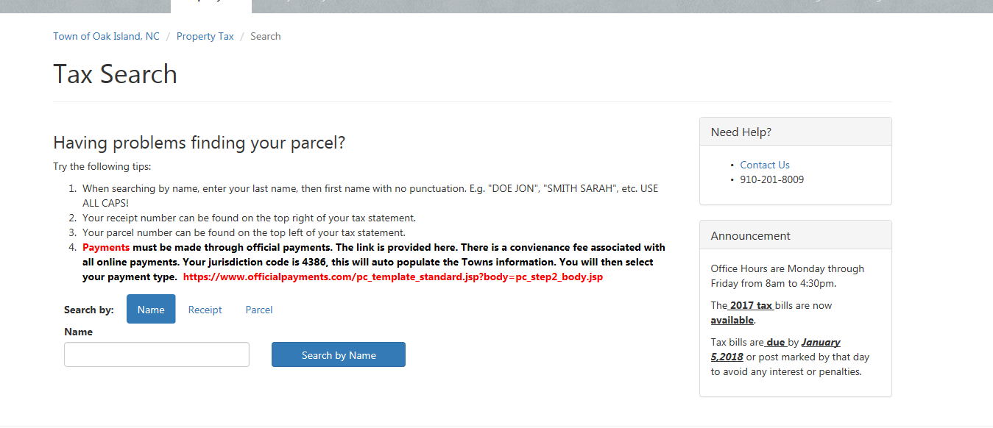
Cont..
Once you click on Property tax it will bring you to this screen, and you can then search by Name, Receipt, or Parcel.

Slide 3
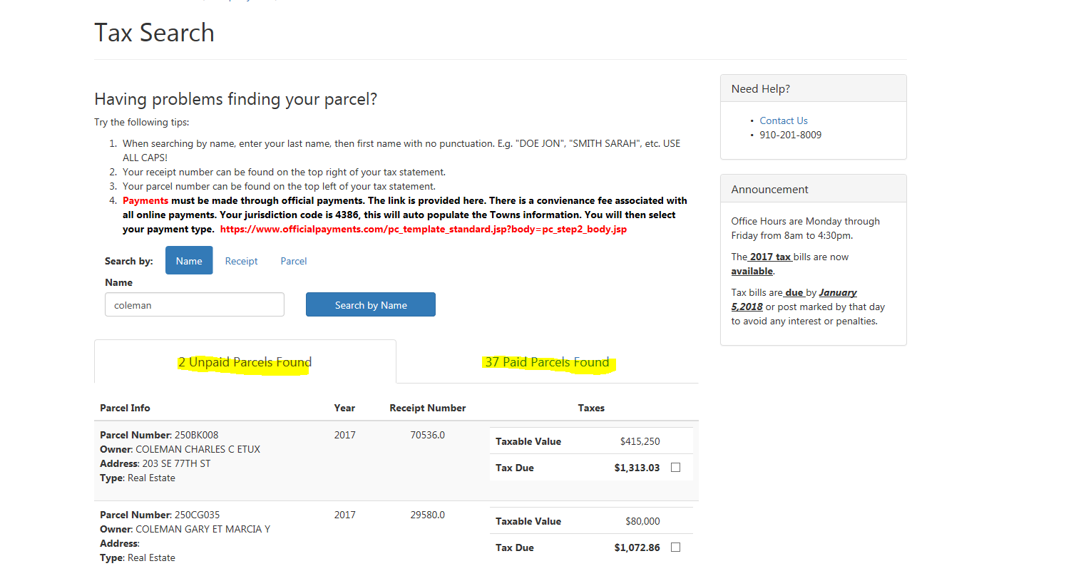
Cont…
I used last name, since that is what most people have. If you do not see yours, please make sure that your looking at the correct spot. So I have highlighted we have 2 unpaid with the last name Coleman, and we have 37 paid with the last name Coleman. So if you are not on unpaid click paid and view. (Tax info back to 2009)

